Slide 1
The 2015 Housing & Economic Outlook
JANUARY 20, 2015 || 1:00 – 2:00 PM
^{Presenter(s):}
David Crowe|| NAHB, Washington, DC
David Berson|| Nationwide Insurance, Columbus, OH
Frank Nothaft|| Freddie Mac, Washington, DC

Slide 2
2015 Housing & Economic Outlook
This session discusses the near-term and long-term outlook for the housing market. For 2015, the presentation will focus on mortgage rates, credit availability, and job growth. For the longer term, the presentation will examine the latest demographic data on household formations, homeownership rates, student loan debt, and consumer home buying attitudes. The speakers will analyze each of these components of near- and longer-term housing demand and present a unified view of what the economic and demographic outlook suggest will happen to housing demand.

Slide 3
Learning Outcomes
Learn about the economic and housing projections for 2015.
Understand the effect of rising mortgage rates on home buyers.
Learn about the demographic drivers of long-term housing demand.
Understand the demographic risk factors that could either strengthen or dampen housing demand in coming years.
Learn what the latest data on homeownership rates, household formations, student loan debt, and consumer home buying attitudes suggest for housing demand in 2015 and beyond.

Slide 4
American Institute of Architects (AIA) Continuing Professional Education
Credit(s) earned on completion of this course will be reported to AIA CES for AIA members upon completion of the AIA/CES Session Participation Forms found in the back of this session room and online at www.BuildersShow.com. Certificates of Completion for both AIA members and non-AIA members are available upon request.
This course is registered with AIA CES for continuing professional education. As such, it does not include content that may be deemed or construed to be an approval or endorsement by the AIA of any material of construction or any method or manner of handling, using, distributing, or dealing in any material or product.
Questions related to specific materials, methods, and services will be addressed at the conclusion of this presentation.

Slide 5
What is the outlook for mortgage rates and home sales in 2015? (Both up)
Are we in another house-value ‘bubble’? (No)
Will student debt affect future housing market? (Yes)
Where are residential originations headed? (Less single-family refinance but more purchase, and more multifamily)

Slide 6
What is the outlook for mortgage rates and home sales in 2015? (Both up)
Are we in another house-value ‘bubble’? (No)
Will student debt affect future housing market? (Yes)
Where are residential originations headed? (Less single-family refinance but more purchase, and more multifamily)

Slide 7
Federal Funds Target Expected to Rise
Dec – 14 Median
0.13
1.13
2.50
3.63
3.75
Fed Funds Futures
0.12
0.61
1.50
2.00
Source: Fed Futures from Bloomberg on 12/17/2014. In the bottom plot each shaded circle indicates the value (rounded to the nearest 1/8 percentage point) of an individual FOMC participant’s judgment of the appropriate level of the target federal funds rate at the end of the specified calendar year or over the longer run.

Slide 8
Fixed-Rate Mortgage Rates To Slowly Rise
Source: Freddie Mac Primary Mortgage Market Survey®., U.S. Board of Governors of the Federal Reserve System (H.15)

Slide 9
Sales Forecast: 2015 Up 4% from 2014 (Most Annual Sales Since 2007)
Forecast
Sources: US Census Bureau, National Association of Realtors®; “Peak” is 2005Q3.

Slide 10
What is the outlook for mortgage rates and home sales in 2015? (Both up)
Are we in another house-value ‘bubble’? (No)
Will student debt affect future housing market? (Yes)
Where are residential originations headed? (Less single-family refinance but more purchase, and more multifamily)

Slide 11
For-Sale Inventory of Homes Has Recently Been Very Low
Sources: National Association of Realtors, U.S. Census Bureau (New Residential Sales and Housing Vacancy Survey)
Note: Existing home inventory excludes Condo & Co-op Inventory before 1999.

Slide 12
REO and Short Sales Dropped over the Past Year
Percent Change in Sales
(Jan-June, 2013 vs 2014)
-44% Short
-20% REO
0% Non-Distressed
-5% Total
Total Distressed Sales
Source: CoreLogic Market Trends, through September 2014
12

Slide 13
Vacancy Rates: Rental is ‘Tight’, For-Sale Close to ‘Average’
Excess Vacant Homes (Numbers in Millions)
-0.2
Source: Freddie Mac calculations using U.S. Census Bureau data. Negative values reflect undersupply. The under/oversupply of vacant housing was estimated based on the average vacancy rate from 1994Q1 to 2003Q4.

Slide 14
House Prices Up 20% from Trough (but Are Still Down 11% from Peak)
Freddie Mac House Price Index (December 2000=100)
11%
Down
Forecast
United States
2015:
3.5% Up
20% Up
Values Generally Back to 2005 Levels
Source: Freddie Mac House Price Index (Seasonally-Adjusted; January 2000-September 2014), January 2015 Outlook

Slide 15
House Price Performance By State, Sept. 2013 to Sept. 2014
United States 5%
7%
WA
NH
4%
ME
5%
MT
8%
ND
0%
VT
7%
OR
1%
MN
1%
NY
4%
MA
3%
ID
3%
SD
3%
WI
4%
8%
MI
3%
WY
2%
PA
RI 6%
5%
NE
3%
IA
CT -1%
4%
OH
NJ 1%
13%
NV
4%
IL
4%
IN
4%
WV
0%
DE 6%
3%
UT
4%
VA
8%
CA
7%
CO
4%
KS
4%
MO
MD
KY 3%
DC 7%
3%
OK
TN 6%
NC 3%
4%
AZ
3%
NM
5%
AR
6%
SC
4%
AL
7%
GA
≥ 8%
5%
MS
5 to 7%
8%
TX
3%
LA
2 to 4%
5%
AK
8%
FL
-1 to 1%
7%
HI
Source: Freddie Mac. The Freddie Mac House Price Index for the U.S. is a value-weighted average of the state indexes where the value weights are based on Freddie Mac’s single-family credit guaranteed portfolio. Percent changes were rounded to nearest whole percentage point.
Notes:
15

Slide 16
House Price Performance By State, June 2006 to Sept. 2014
United States -11%
-8%
WA
NH
-7%
ME
8%
MT
50%
ND
-3%
VT
-7%
OR
-11%
MN
-9%
NY
-15%
MA
-12%
ID
14%
SD
-11%
WI
-7%
11%
WY
-14%
MI
RI -22%
5%
IA
-5%
PA
7%
NE
-9%
OH
CT -20%
-20%
IL
0%
IN
-20%
NJ -20%
-36%
NV
7%
WV
DE -12%
3%
UT
13%
CO
5%
KS
-8%
MO
-10%
VA
MD
-17%
CA
KY 2%
DC 30%
TN 4%
NC -3%
11%
OK
2%
AR
-3%
SC
-28%
AZ
-11%
NM
≥ 0%
-2%
MS
-5%
AL
-10%
GA
-9 to -1%
24%
TX
6%
LA
-20 to -10%
11%
AK
≤-21%
-31%
FL
5%
HI
Source: Freddie Mac. The Freddie Mac House Price Index for the U.S. is a value-weighted average of the state indexes where the value weights are based on Freddie Mac’s single-family credit guaranteed portfolio.

Slide 17
What is the outlook for mortgage rates and home sales in 2015? (Both up)
Are we in another house-value ‘bubble’? (No)
Will student debt affect future housing market? (Yes)
Where are residential originations headed? (Less single-family refinance but more purchase, and more multifamily)

Slide 18
Student Loan Debt Has Become More Prevalent Across All Age Groups
Source: Harvard Joint Center for Housing Studies tabulations of Federal Reserve Board, Survey of Consumer Finances.

Slide 19
Households with Substantial Student Loan Debt Today Have Less Education, Making Repayment More Difficult
Note: Excludes households without student loan debt. Debt levels adjusted to 2013 dollars using CPI-U for All Items.
Source: Harvard Joint Center for Housing Studies tabulations of Federal Reserve Board, Survey of Consumer Finances.

Slide 20
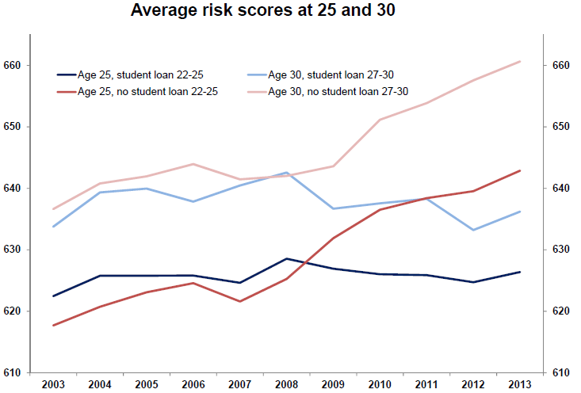
Millennials Without Student Debt Have Higher Credit Scores
Source: Federal Reserve Bank of New York Consumer Credit Panel, Equifax.

Slide 21
What is the outlook for mortgage rates and home sales in 2015? (Both up)
Are we in another house-value ‘bubble’? (No)
Will student debt affect future housing market? (Yes)
Where are residential originations headed? (Less single-family refinance but more purchase, and more multifamily)

Slide 22
Purchase-Money Will Dominate Origination Mix
Single-Family Mortgage Originations ($ Billions)
Lowest
Level
Since
2000
Origination Activity Projected to Decline by About $1 Trillion 2012 to 2015
Sources: Freddie Mac’s January 2015 Economic Outlook, HUD, VA

Slide 23
Multifamily Mortgage Originations Projected Up
Multifamily Mortgage Originations (Billions of Dollars)
Forecast
Sources: FFIEC (HMDA), OTS Thrift Financial Report, ACLI Investment Bulletin, MBA Commercial Mortgage Banker Origination Survey, Freddie Mac.

Slide 24
Where to Get More Information
Look for regular updates to our economic forecast, commentary and data at
www.FreddieMac.com/news/finance
Contact us at chief_economist@freddiemac.com
Twitter: @FreddieMac
Opinions, estimates, forecasts and other views contained in this document are those of Freddie Mac's Office of the Chief Economist, do not necessarily represent the views of Freddie Mac or its management, should not be construed as indicating Freddie Mac's business prospects or expected results, and are subject to change without notice. Although the Office of the Chief Economist attempts to provide reliable, useful information, it does not guarantee that the information is accurate, current or suitable for any particular purpose.
Information from this document may be used with proper attribution. Alteration of this document is prohibited. © 2015 by Freddie Mac.
24

Slide 25
Speaker Contacts:
John Smith
ABC Builder
202.555.5555
1234 Elm Street
Cleveland, OH 50003
John Smith
ABC Builder
202.555.5555
1234 Elm Street
Cleveland, OH 50003
Frank E. Nothaft
Freddie Mac
703-903-2350
8200 Jones Branch Drive
McLean, VA 22102-3110
Head Shot
Head Shot
Head Shot

